Slide 1

St. Mary’s
Religious Education online registration
A step-by-step guide to creating a ParishSOFT account and registering you children for Religious Education

Slide 2
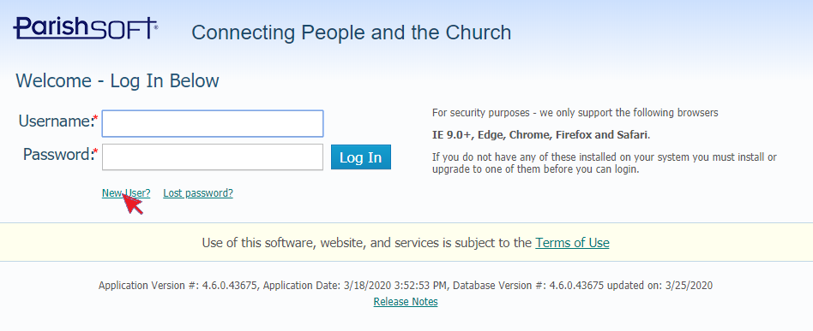
NOTE ; IF YOU ALREADY HAVE A PARISH-SOFT “MY CHURCH “ ACCOUNT ----- SKIP TO PAGE 6
Do not create a new account- the system will lock out your account!!!
Step 1 (Login Page): On the ParishSOFT login page, click on “New User”. This will bring you to the “Account Request” page. https://allentown.parishsoftfamilysuite.com

Slide 3
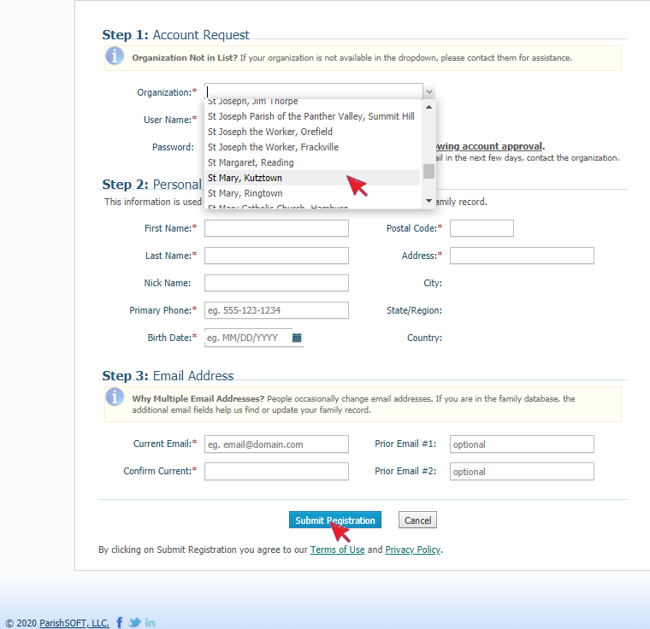
Step 2 (Account Request Page): On the Account Request page, pick “St. Mary, Kutztown” on the drop-down menu in the “Organization” field. Then fill out the required information and click on the “Submit Registration” button. After submitting your request, you will receive an email once your registration has been processed.

Slide 4
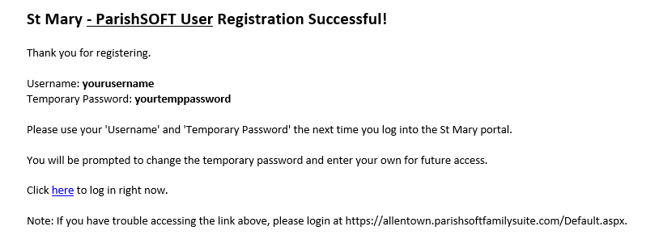
Step 3 (ParishSOFT User Registration email): In the ParishSOFT User Registration email, you will receive your temporary password.
You can click on the supplied link to the login page.
If you had issues creating an account you can watch this more detailed video: https://vimeo.com/102551875

Slide 5
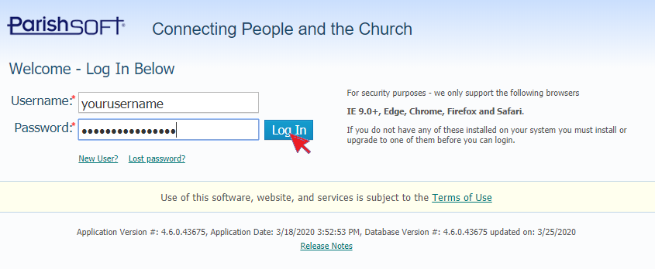
Step 4 (Login Page): On the login page, type in your username and your temporary password. Click on the “Log In” button to log into your account. On your initial login to your account, you will be prompted to change the temporary password to a personal password for future account access. After you have changed your password, you will arrive on your account home page.

Slide 6
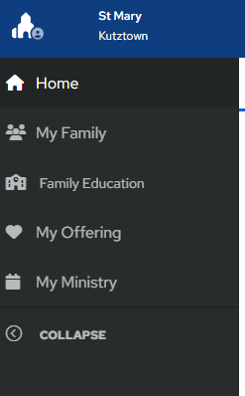
After logging into your account:
(Account Home Page): On your account home page, click on My Family or My Home Church then click on the “Family Education” tab.
Religious Education Registration

Slide 7
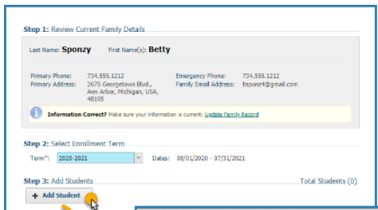
Step 1: Review Current Family Details
Step 1: Shows your current family details if there is any information that must be updated, click the
Update Family Record line and do so presently.
Step 2: Provides a dropdown menu for you to select the term in which you registering your student., select term.
Step 3: Add Student: When you click this button the Registration Form pops-up.

Slide 8
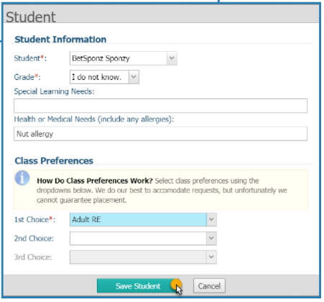
Step 4: Registration Form
When the registration form pops-up fill in the registration form.
Click the
Save Student button.

Slide 9
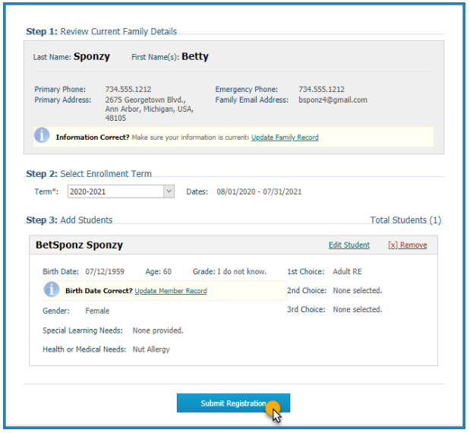
Step 5:
The registration information displays to the screen.
If it looks correct, click
Submit Registration.
If something looks wrong, you may click on any of the provided links to update the information.

Slide 10
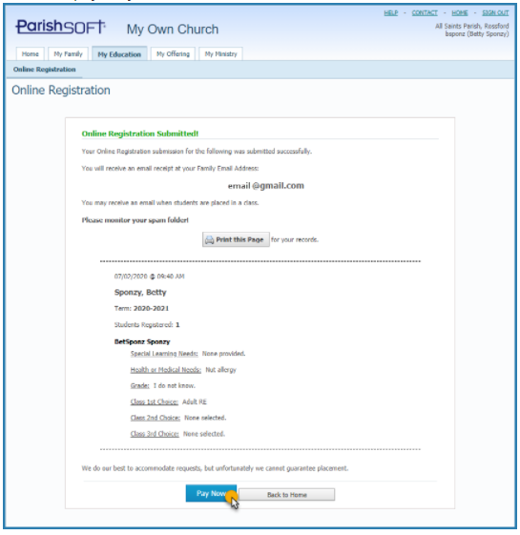
Step 6:
After submitting the registration, you will receive a confirmation screen. It will confirm the information and let you know to expect an email.
PLEASE NOTE:
You cannot make a payment through this program at this time. You must do it by check or the Parish Online Giving program.

Slide 11
TO MAKE A PAYMENT:
Pay with the payment link at time of Registration.
OR
Mail in a check or drop in Sunday Collection basket. Please put child’s name on the check memo.
OR
Use your St. Mary’s Online Giving account to pay. Make payments to REL EDUC and if applicable to SACRAMENTAL.
REGISTRATION FEES FOR 2025-2026 YEAR
At this time Sacramental fees must either be mailed or paid directly on your St. Mary’s Online Giving account.
*Sacramental fees*:
______ $20 for Level 2 – 1st Reconciliation
______ $20 for Level 3 – 1st Communion
______ $20 for Level 8 – Confirmation

Slide 12
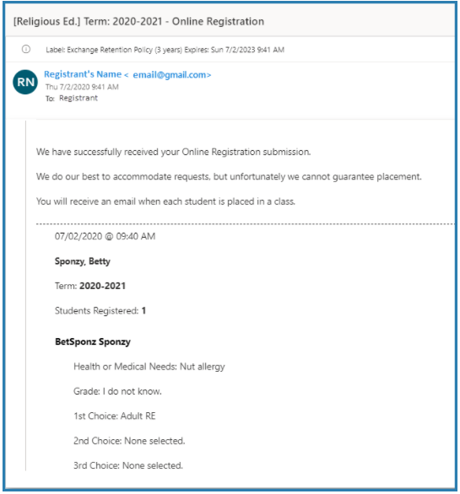
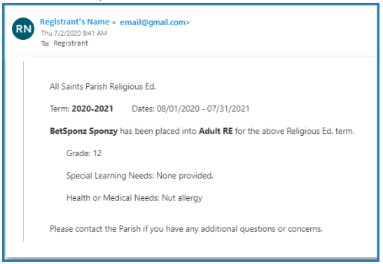
Step 7: Expect two emails.
One email letting you know the student registration has been received.
And another email when the registration has been accepted.
You now completed the Online registration!
If you do not wish to pay online, you can mail the check to the church or drop into the Sunday Collection basket
Please write student’s name on the memo line.

